Slide 1
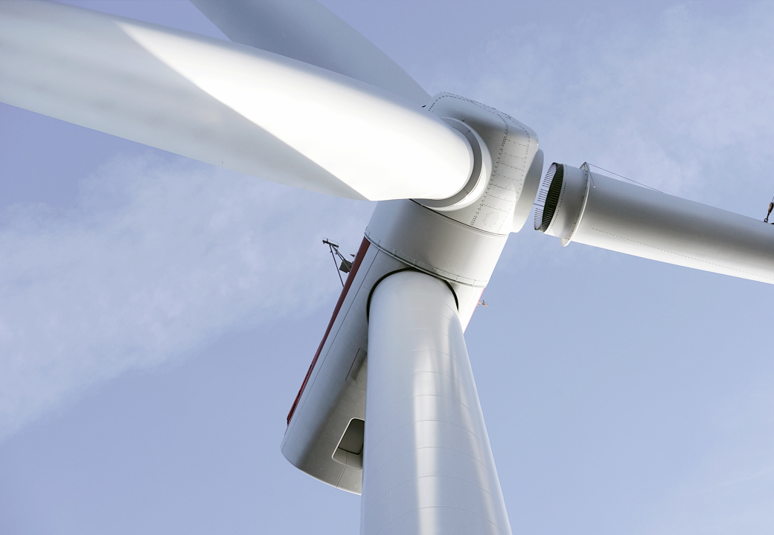

Ørsted
Wind Power
Leading the energy
transformation
March 2018

Slide 2
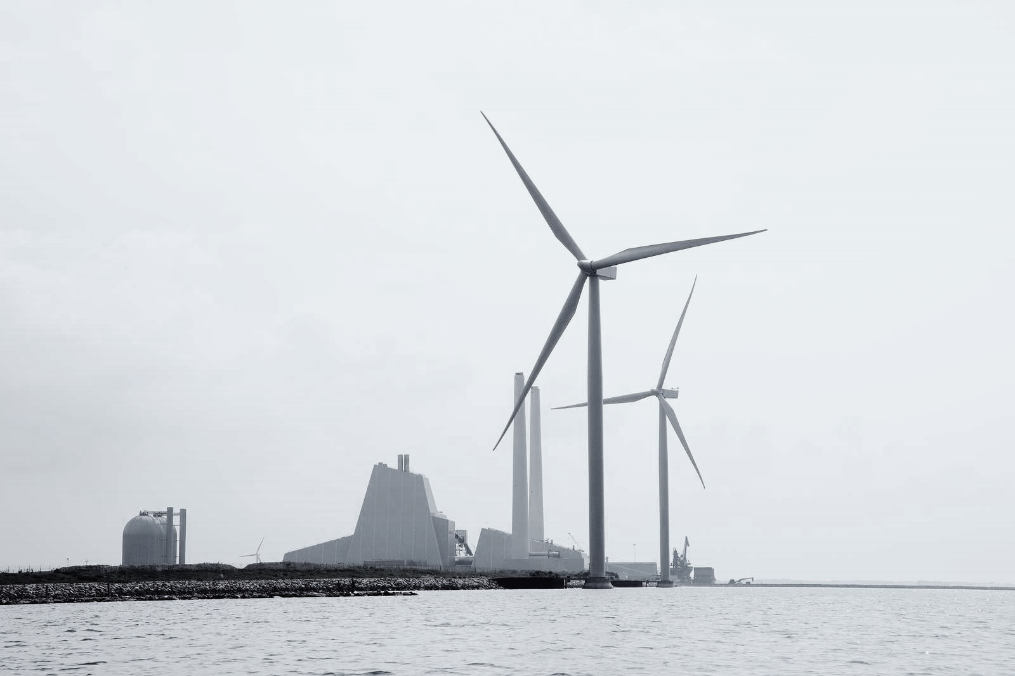



Ørsted at a glance
Headquartered in Denmark
Listed in the Nasdaq OMX: ORSTED
5,638 employees
Revenue in 2017 DKK 59.5 bn (GBP 7.1 bn / EUR 8.0 bn)
EBITDA in 2017 DKK 22.5 bn (GBP 2.7 bn / EUR 3.0 bn )
Phase out the use of coal by 2023
4%* Bioenergy &
Thermal Power
Generates and sells power and heat to customers in Denmark and Northwestern Europe
83%*
Wind Power
  Develops, constructs, owns and operates offshore wind farms in Denmark, Germany, the Netherlands and the UK
  Development projects in Taiwan and the USA
13%* Distribution &
Customer Solutions
Power distribution grid on Zealand and sale of power and gas to customers in Northwestern Europe
* Share of the Ørsted Group’s capital employed, Annual Report 2017

Slide 3


Ørsted Wind Power overview
Global footprint
Unparalleled experience and track record
USA
Europe
Asia Pacific
Bay State Wind
Boston office
Taipei office
25+ years of experience and track record in the offshore wind power sector
Ocean Wind
Formosa 1.1
1991
2018
Coastal Virginia
Formosa 1.2
Greater Changhua projects
Anholt
23 offshore wind farms in operation
5 offshore wind farms under construction
West of Duddon Sands
Middelgrunden
Walney Extension
Westermost Rough
Horns Rev 1 & 2
Avedøre
Walney 1 & 2
Hornsea 1
Vindeby
Hornsea 2
Isle of Man
Hornsea 3 & 4
Nysted
Race Bank
Gode Wind 2
4.4 GW Constructed capacity
~ 2,300 Dedicated employees
4.5 GW under construction
Barrow
Lincs
Gode Wind 3 & 4
Burbo Bank Ext.
Gunfleet Sands 1 & 2
Gode Wind 1
Burbo Bank
Borkum Riffgrund 1
Gunfleet Sands 3
London Array
Borssele 1&2
Borkum Riffgrund 2
Nördlicher Grund
8.8 million
people with clean electricity
4.1 GW
World's leading operator
16 Partnerships
Borkum Riffgrund West 1&2
In operation
OWP West
Under construction
Under development
Decommissioned after 25 years

Slide 4

Ørsted has build a strong integrated end-to-end business model
Ørsted Wind Power core competencies
~2,300
Full-time employees
Develop
Build
Operate
Own
~185
~1,300
~715
~100
Identify and mature projects
Manage construction, sourcing and supply
Conduct life-cycle maintenance
M&A, attract capital through partnerships, asset management
Full-time employees
✓
Ability to design and optimise projects with a 'total life-cycle cost of wind farm' mindset
2,300
✓
Experience and expertise along the entire value chain allow for better understanding and management of risks
✓
End-to-end model reduces LCoE through fast feedback and learning across the entire organisation
650
40
70
100
160
250
250
  Northland
  Power
  Northland
  Power
  Statoil
  SSE
  WPD
  Innogy
  E.ON
  Vattenfall

Slide 5





















Proven track record in developing long-term global partnerships
European partnerships
North American partnerships
Walney Extension (50%)
659 MW (2017)
Lincs (25%)
270 MW (2017)
Horns Rev 1 (40%)
160 MW (2006)
Coastal Virginia ¹
12 MW (2017)
Bay State Wind (50%)
800 MW (2016)
Walney 1&2 (50.1%)
367 MW (2009 / 2010)
Race Bank (50%)
573 MW (2016)
Nysted (42.7%)
166 MW (2010)
West Duddon Sands (50%)
389 MW (2010)
Westermost Rough (50%)
210 MW (2014)
Anholt (50%)
400 MW (2011)
Asia Pacific partnerships
Gode Wind 2 (50%)
263 MW (2014)
Gode Wind 1 (50%)
344 MW (2015)
Burbo Bank Extension (50%)
258 MW (2016)
Borkum Riffgrund 1 (50%)
312 MW (2012)
Gunfleet Sands (50%)
173 MW (2011)
London Array (25%)
630 MW (2009 / 2014)
Borkum Riffgrund 2 (50%)
450 MW (2017)
Formosa 1 (35%)
128 MW (2016)
(%) represents Ørsted ownership interest and year when the partnership was created
1- In 2017 Ørsted and Dominion Energy entered into a strategic partnership in which Ørsted will construct two 6-megawatt turbines off the coast of Virginia Beach

Slide 6

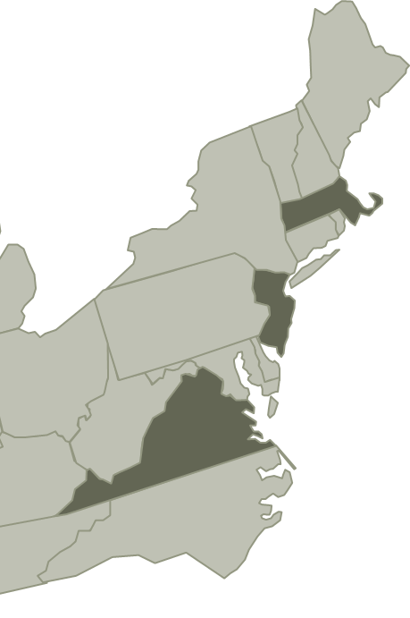


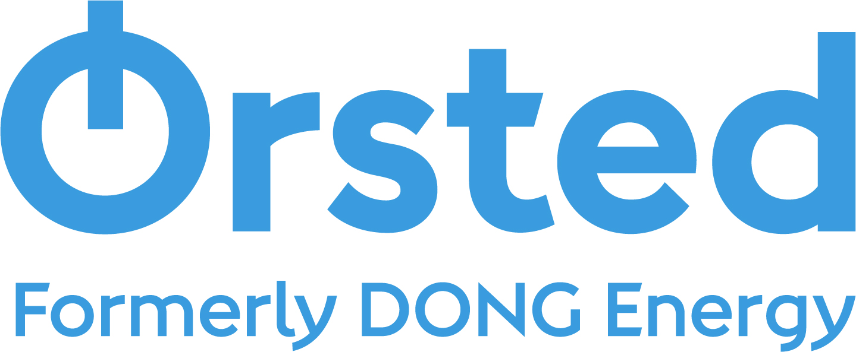
Ørsted Wind Power in the U.S.
Secured project rights for ~3 GW capacity
Entered U.S. 50/50 JV for Bay State Wind¹ with Eversource in 2016
Announced Coastal Virginia Offshore Wind partnership with Dominion Energy in July 2017
Bay State Wind
2,000 MW potential capacity
15 miles from Martha’s Vineyard
Connecting into Massachusetts
Water depths of 100 – 125 feet
Bay State
Wind
Ocean Wind
CVOW
Ocean Wind
+2,000 MW potential capacity
10 miles from shore
Connecting into New Jersey
Water depths of 65 – 100 feet
  Coastal Virginia
  Offshore Wind
Coastal VA Offshore Wind
12 MW Stage 1 (demo) windfarm
22 miles from shore
Connecting into Virginia
Water depths of 80 – 100 feet
Offtake, grid connections and planning consents have not yet been secured

Slide 7
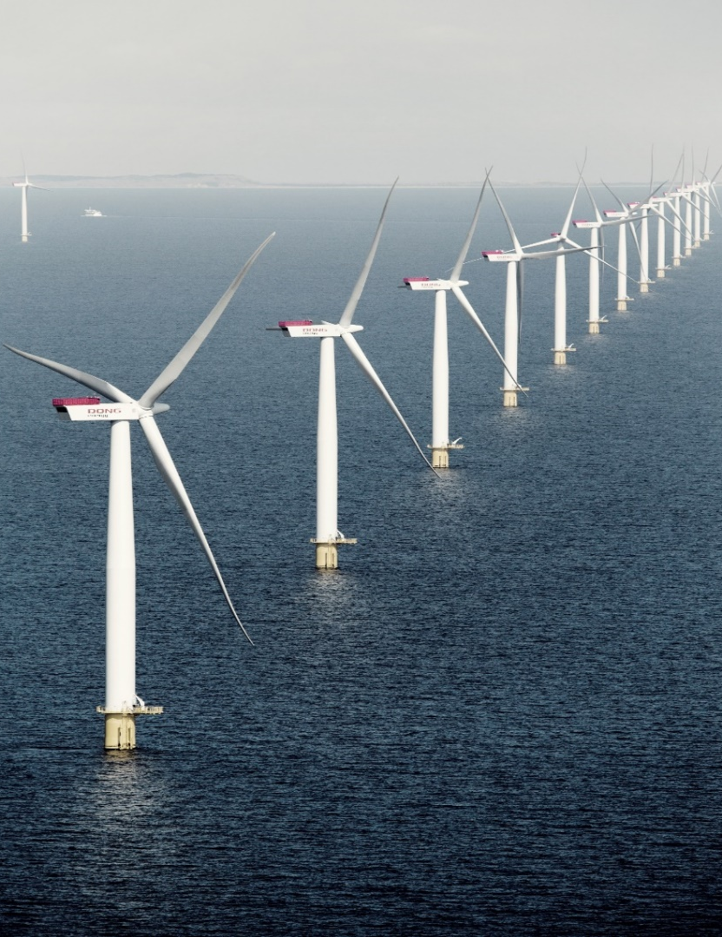
Bay State Wind Development
MA legislation requires procurement of 1,600 MW of offshore wind by 2027
  Bids submitted December 2017
  Winners selected in April 2018
  Next RFP in June 2019
Bay State Wind
  50/50 partnership between Ørsted and Eversource announced in December
  Jointly own ~300 square mile lease 15-25 miles south of Martha’s Vineyard
  Capacity to hold at least 2,000 MW
Work has begun on key elements of development, drawing on the partners’ expertise and Ørsted’s experience from Europe

Slide 8
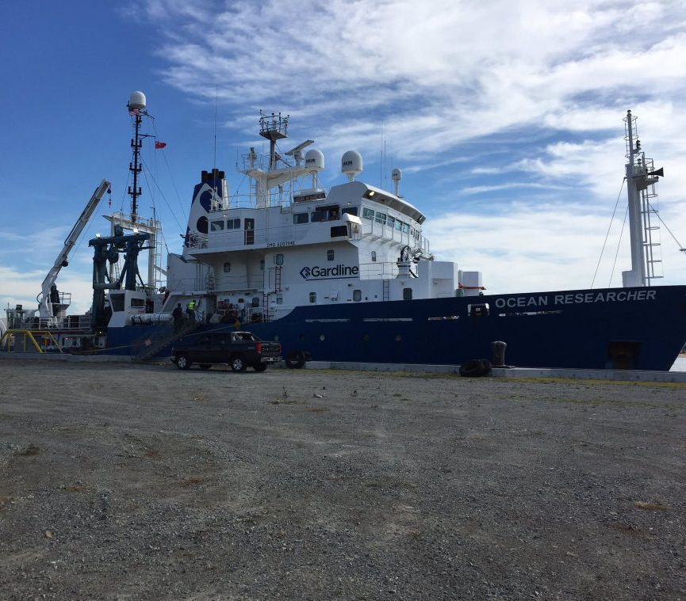
Ocean Wind Development
Offshore Wind and Economic Development Act of 2010 provides a framework to support the financing and deployment of OSW in NJ
Governor Murphy issued an EO January 31 in support of the development of 3,500 MW of offshore wind power by 2030
The BPU will issue a solicitation for 1,100 MW of offshore wind in 2018
Ocean Wind
  Ørsted owns lease 10+ miles offshore Atlantic City
  Capacity to hold at least 2,000 MW
  Project work underway

Slide 9
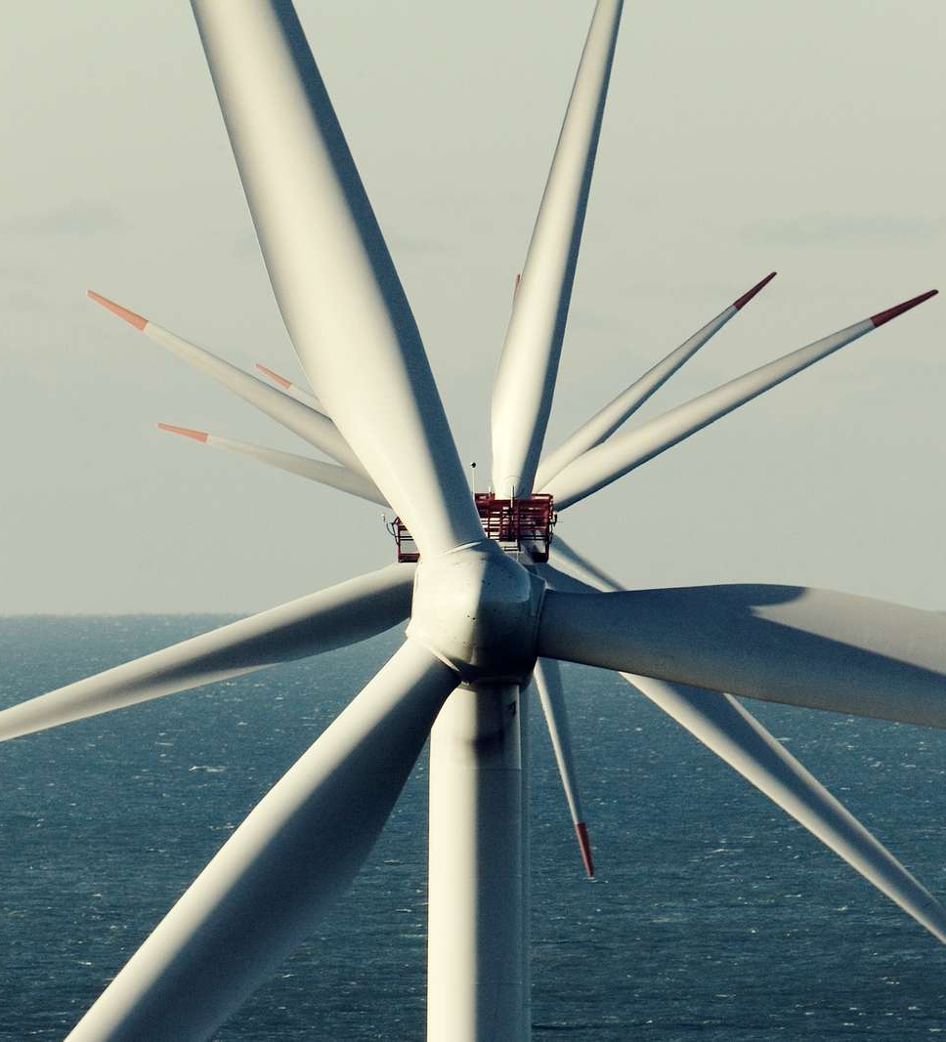
Coastal Virginia Offshore Wind Project
Entered EPC arrangement to build Mid Atlantic’s first OSW project, Coastal Virginia Offshore Wind, with commissioning expected by 2020
Entered strategic partnership with Dominion to explore large, commercial scale project. Project site has potential to build up to 2,000MW
Ørsted established an office in Richmond, VA
Commencing exploration of Norfolk and other port and supply chain opportunities

Slide 10
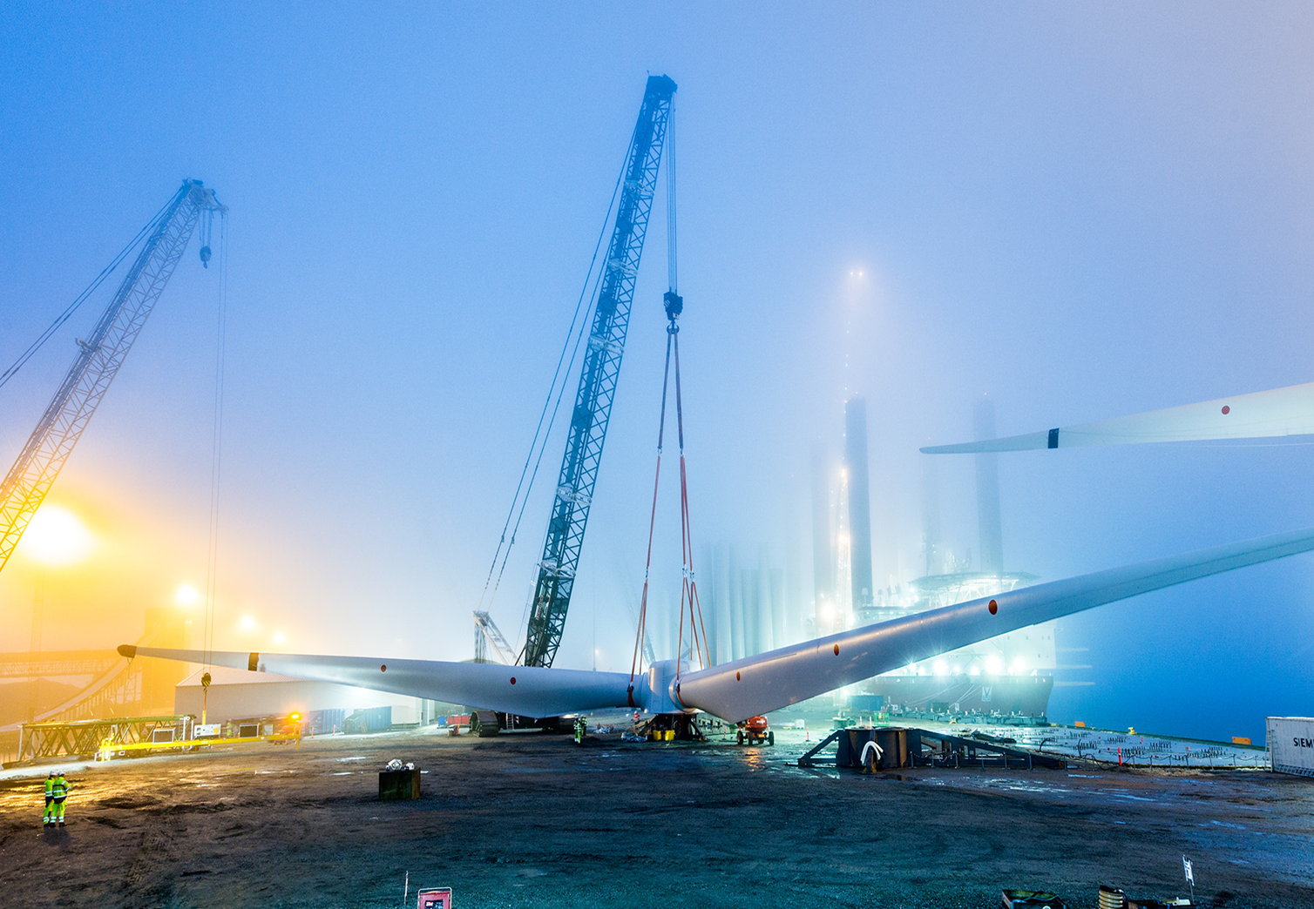
Q&A

